Slide 1
Autonomous Turret
Alex Niculescu & Jamie Wang
Notes:
Our project proposal is to create an autonomous turret to seek out and fire on moving targets

Slide 2
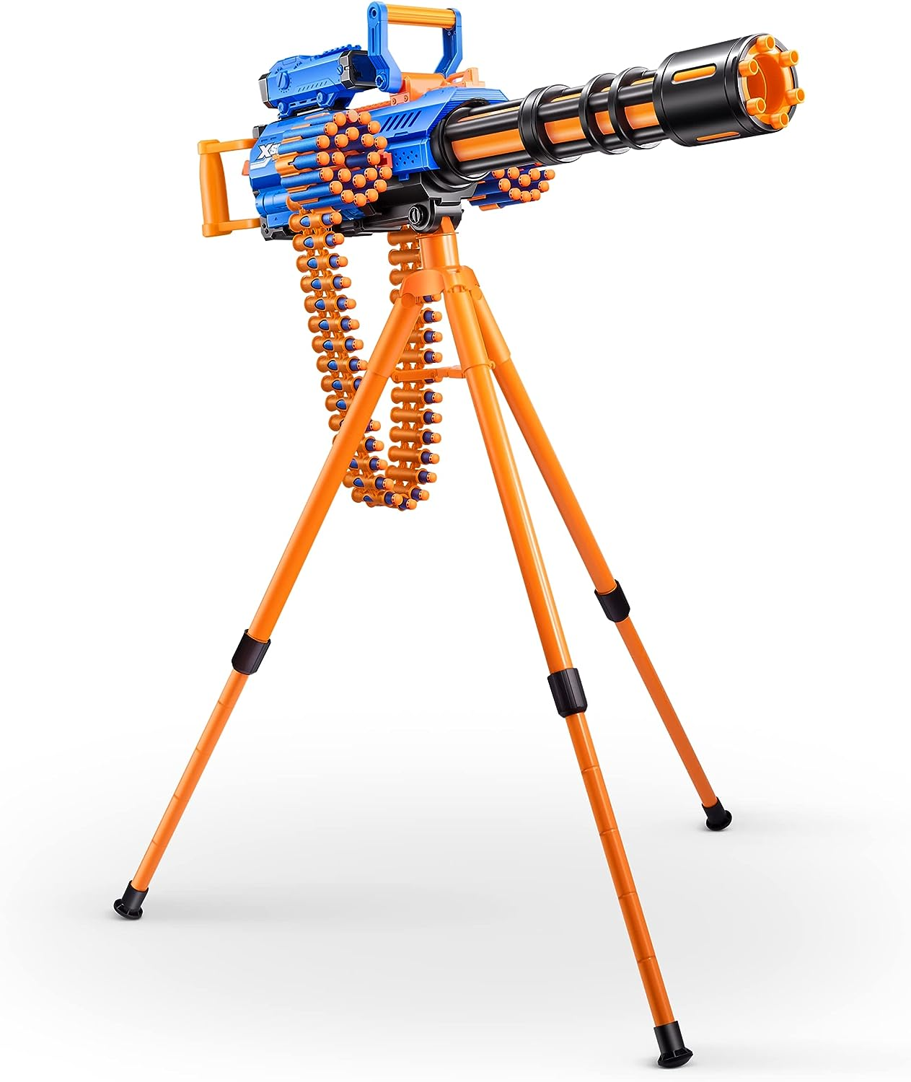
X-Shot Insanity Motorized Rage Fire by ZURU 72
*Rated ages 8 and up
Notes:
The main concept of our project is to create an autonomous foam-dart turret. To create the turret, we plan to use a automatic Nerf-like gun like the one shown here which will be mounted on a tripod. The gun will have automatic firing which will allow it to fire continuously without any human intervention (until it needs to reload). We will constrain it to move on one axis, left or right. The movement and firing will be controlled with motors and the sensing will happen with IR sensors to detect moving objects that output IR waves (like living creatures)

Slide 3
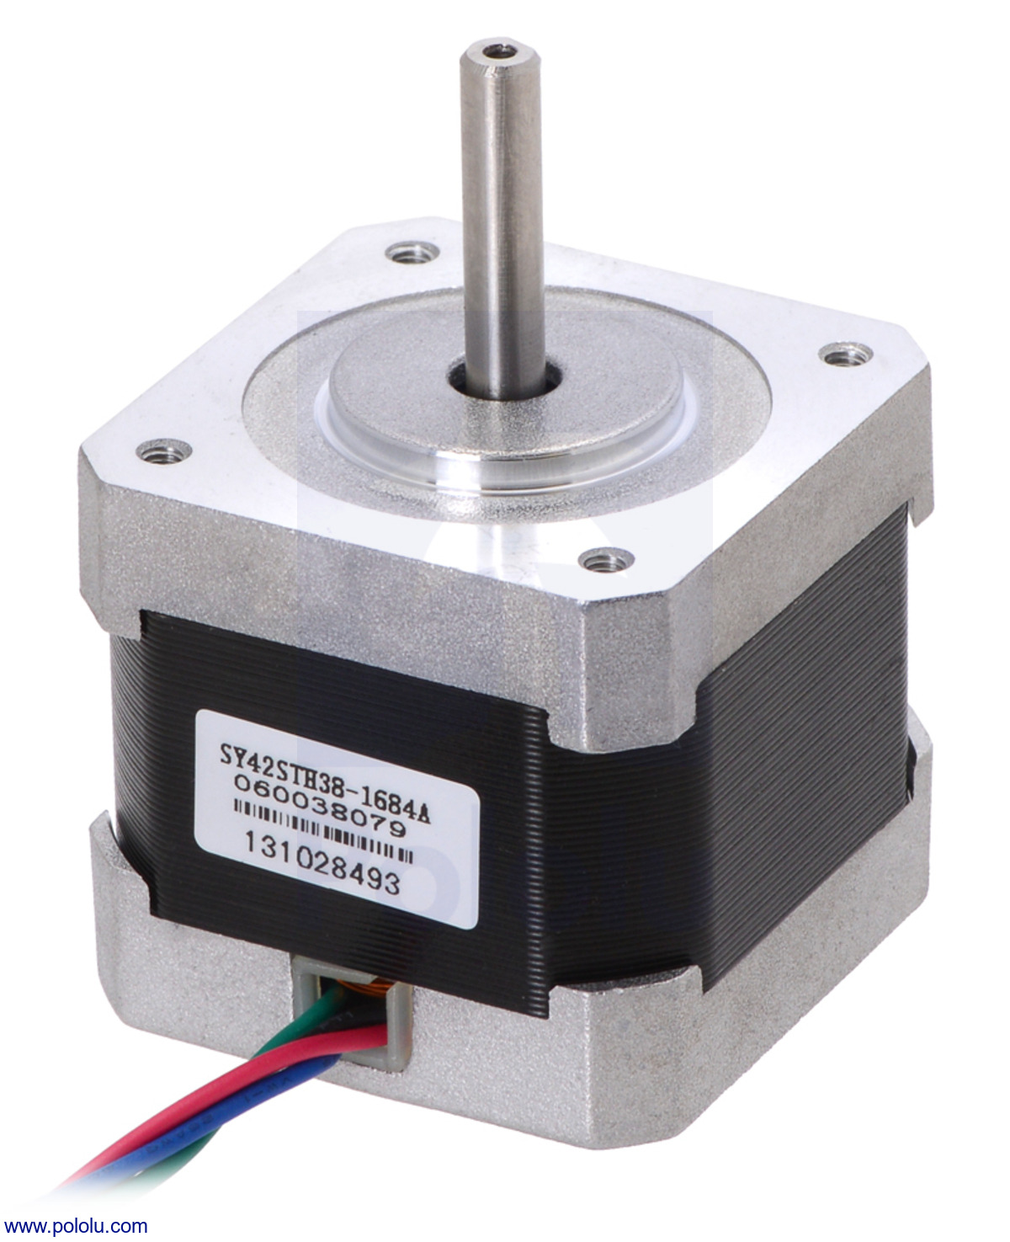
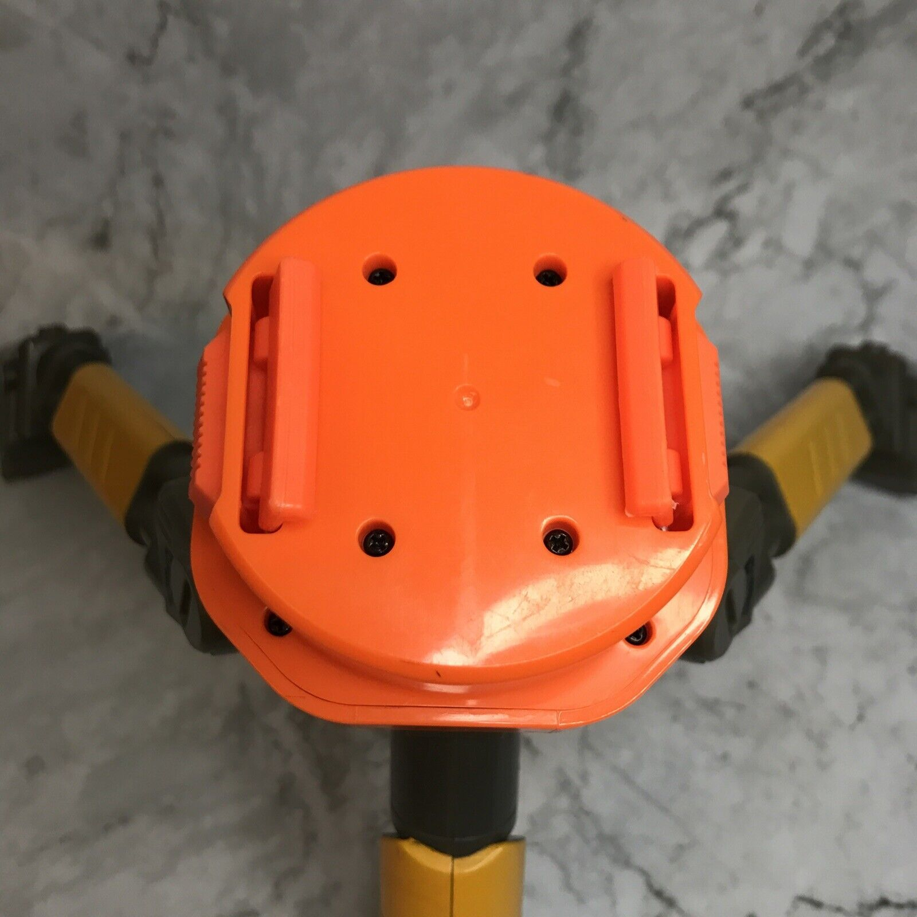
Motorized
Notes:
To make the turret move automatically, we will make a coupling between the tripod and the gun and attach a stepper motor on it that will control the rotation of the gun. The motor will allow us to control the angular rotation of the turret and let us specify where the turret should rotate based on the data gathered from the detection control. We are considering options like a stepper motor, DC motor with an encoder, or a 360 degree servo for this purpose.
Will need external power supply for motor like 12V battery

Slide 4
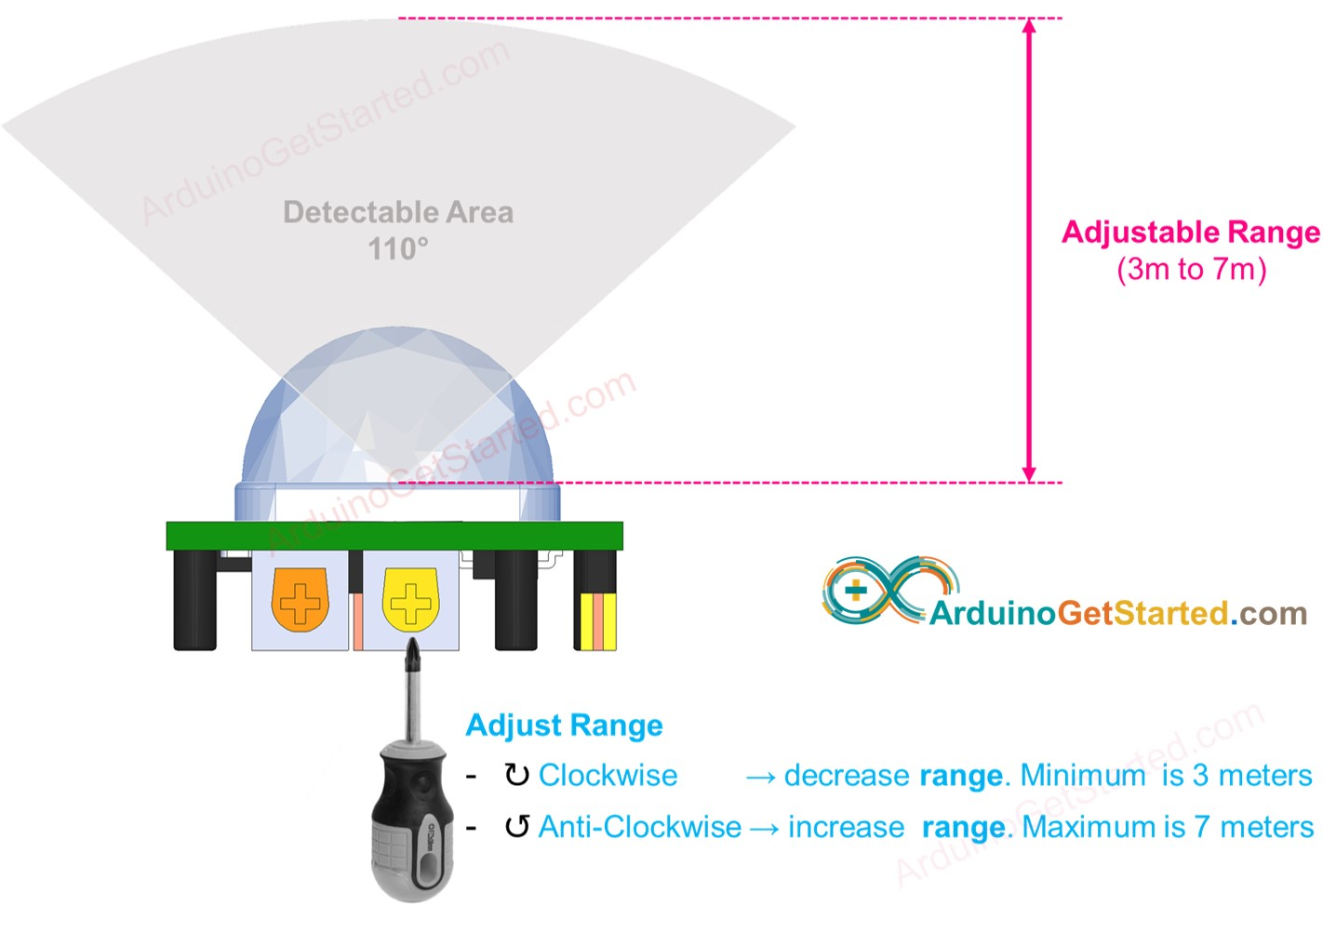
Automatic Target Sensing
Notes:
The main detection mechanism will be through IR sensors. Multiple IR sensors will be necessary to construct a 360 degree field of vision. We are considering using either PIR sensors, Passive Infrared sensors, or potentially an IR camera. While the PIR sensor is much cheaper and simpler, it will also be unable to specifically determine the location of the target. IR cameras will be able to specifically locate the target within the field of view, but are more expensive and will require more computation. Another option is to apply many PIR sensors and determine the center of a range of sensors that are triggered, but it will require many more sensors.
One potential challenge is what to do if multiple targets are detected at once. We will need to have a way to differentiate targets so we can target them separately, perhaps in order that they appear.

Slide 5
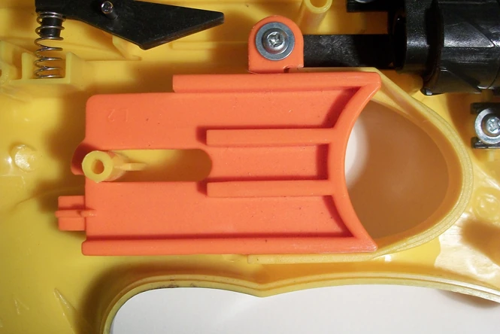
Communication & Control
PIR: Wire goes high when sensor detects movement Possibly use interrupt handlers for when a PIR sensor goes high
IR Camera: Creates 2D array of temperatures we can use to find target
Aiming Mechanism: Based on what combination of PIR sensor detect movement, stepper motor rotates to specific position. Will need to learn how to control the motor with ESP32
Servo Motor: Use PWM to trigger firing pin
Notes:
In terms of integrating the detection and motor assemblies together, we plan to continue using the WiFi LoRa 32 that we’ve been using in class since we should have enough pins to connect everything.
If we use PIR sensors have an output pin that goes high for a few seconds every time it detects motion. A possible way to integrate them is to attach an interrupt handler to the connected pins to indicate when movement is detected
If we use IR Camera, it will create a 2D array of temperatures we can parse to find the target
For the aiming mechanism, we will design a program to read which sensors have detected motion and aim at the correct position. For example, if two neighbouring sensors detect movement at the same time, the turret would aim to a location between the two sensors.
Finally, we will need to control a servo motor to trigger the firing pin. We will need to use PWM to control its position

Slide 6
Mobile App: Remote Control
Option for user to control turret remotely
Simple button layout to move turret side to side and button for firing
(Extra Flavor): Add a camera for user to see what turret is firing at without physically being there
Phone Screen
FIRE
Notes:
We will also create a mobile app to communicate with the turret through WIFI to allow a user to remotely control the turret. The current plan is to have controls to move the turret left and right and to fire it. We will also have other controls to turn on/off the turret, go back to autonomous mode, etc. This also acts as a safety switch in case it needs to be turned off due to faulty behaviour or it turns against its user.

Slide 7
Timeline
Week 3/18 | Finish ordering parts
Week 3/25 | Test and assemble individual components
Week 4/1 | Couple components Create control flow
Week 4/8 | Finish mobile app
Week 4/15 | Testing and Refinement
Week 4/23 | Presentation!

Slide 8
Thank You!

